Slide 1
How a Bill becomes a Law
Chapter 8
Section 4

Slide 2
Thousands of Bills
Bills may be introduced in either house
One EXCEPTION – appropriation bills (approving the spending of money) must originate in the HR
Every bill must be passed by both houses before it can be signed by the president and become a law

Slide 3
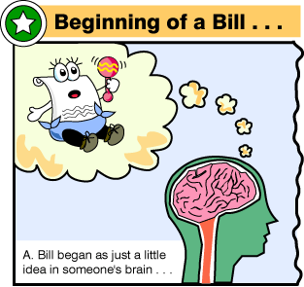
The Idea for a Bill Begins
From…
U.S. citizens
Organized groups (ex. Labor groups)
Committees of Congress
Members of Congress
The President

Slide 4
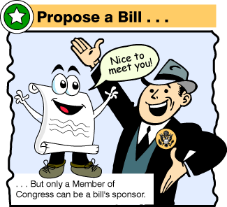
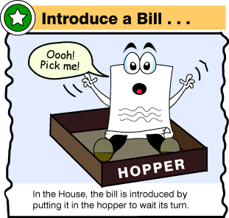
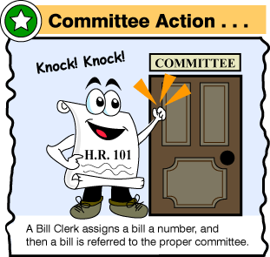
How does an idea become a bill?
Only members of Congress can introduce bills
Bill is carefully written out
Dropped in the hopper
Given letters and a number (ex. HR 1218 or S 1008)
Sent to standing committee for study
Usually the subject of the bill determines which committee will study it

Slide 5
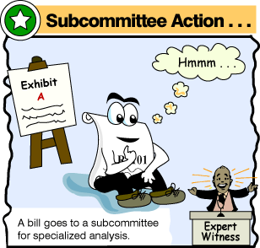
In committee – holds hearings
Each bill is carefully considered
Some are found unnecessary and are set aside
Hearings are held for the bills they want to consider
Most committee hearing are open to the public
Committee may call witnesses to testify for and against the bill

Slide 6
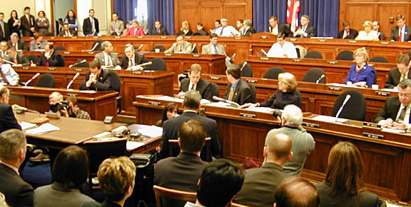
A House Committee in action

Slide 7
In committee – studies the bill
The committee may rewrite parts of the bill
Let say we are talking about a bill that has been in a House committee (HR 1218)
If the committee decides to approve the bill it is then sent to the whole House for consideration

Slide 8
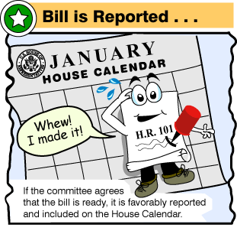
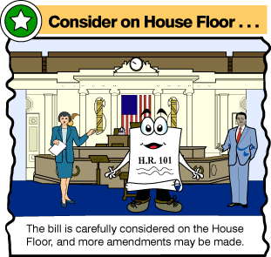
The House considers the bill
Once it is sent to the House it is put on the House calendar – schedule that lists the order in which bills are considered
In an emergency, a bill can be moved up on the calendar so action can be taken quickly
HR 1218 must be given 3 readings in the House
Rules Committee decides how much time will given to debate the bill
During debate, the House usually acts as a Committee of the Whole

Slide 9
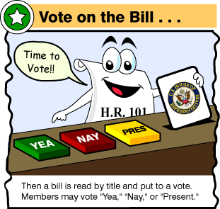
The House Votes
When a quorum is present (a majority of members must be present to do business), a vote is taken
On important bills a roll-call vote is usually taken
Each member’s name is called and a record is made of his or her vote

Slide 10
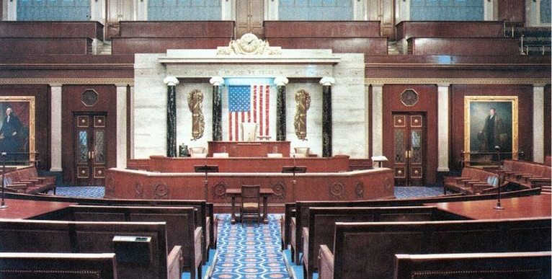
House of Representatives

Slide 11
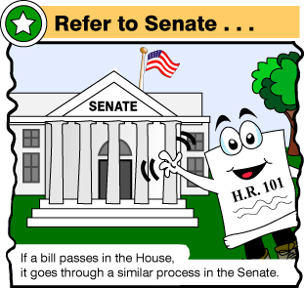
The Senate Acts on the Bill
Once the bill is passed in the House, it is sent to the Senate and the process starts all over
However, in the Senate there is not a time limit on debate
Speeches may last a long time
Filibusters may be used to delay or “talk a bill to death”
Debate can be limited if 3/5ths of the full Senate vote to limit it – called cloture

Slide 12
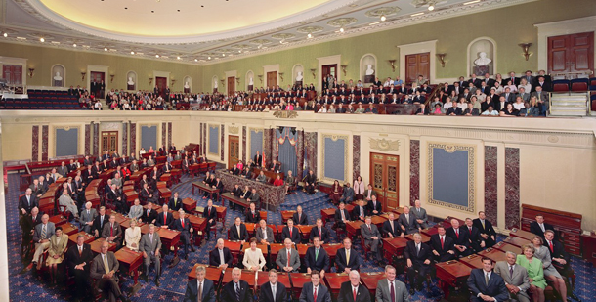
Senate

Slide 13
If the House & Senate don’t agree on the final bill
Usually, the HR and Senate pass different versions of the same bill
If the bill is changed in any way, it must be sent back to the house in which it started for another vote
A conference committee (equal number of senators & representatives) meets to reach an agreement
A compromise bill is sent back to both houses for another vote

Slide 14
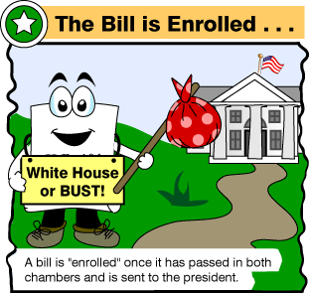
After both houses approve the bill
It is sent to the President
May take 1 of 3 possible actions on a bill
1. President may sign the bill & declare it to be a law
2. Veto - may refuse to sign & send it back to Congress with a message giving the reasons for rejecting it
3. May keep the bill for 10 days without signing it. If Congress is in session the bill becomes a law without the President’s signature. If Congress is not in session, and the President does not sign the bill is killed by a pocket veto.

Slide 15
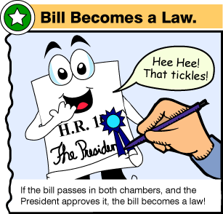
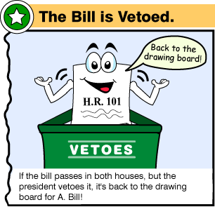

Slide 16
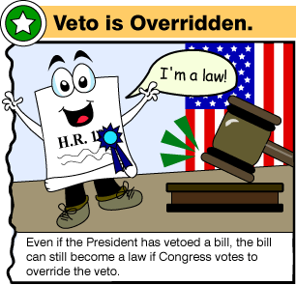
Can the bill still become a law if the President vetoes it?
Congress can still pass a bill over a presidential veto
2/3^{rds} of both houses of Congress must agree

