Slide 1
The Legislative Branch
Chapter 8

Slide 2
The Members of Congress
Section One

Slide 3

The Responsibilities of Lawmaking
Most important job of Congress is to make laws.
Congressmen must balance the needs of different groups of people.
Local versus national needs
  Congressmen/women represent their constituents.
  Congressmen/women also represent the whole nation.
Sometimes the needs of the two come into conflict with one another.

Slide 4
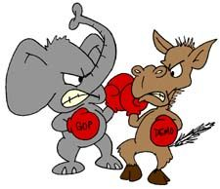
The Responsibilities of Lawmaking
Political party they belong to
  Democratic
  Republican
Pressure to support the party’s position on issues before Congress.
In event of a conflict, who should he/she side with constituents, nation, party, etc?
Notes:
A party is an organization that shares certain ideas about what government should do
Example of difficult choice from book-The senator who received Diana Perez’s letter about the bill (proposed law) to increase minimum wage was pressured from two sides. This senator was a Republican. The party opposed the bill as a whole. Most of his letters from constituents supported the bill. What would you do?

Slide 5
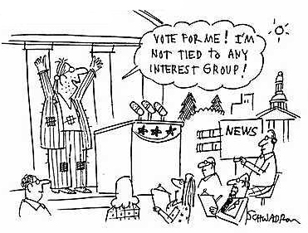
The Responsibilities of Lawmaking
Interest Groups
  Groups of people who work together for similar interests or goals.
  Can supply votes and money.
  Example: American Medical Association
  Work to convince senators and representatives to support bills that help their members and oppose bills that hurt members.
  Done through lobbyists.
    People who represent interest groups.
  If Congressman supports the goals of a group, the group will push its members to vote for him/her.

Slide 6
The Responsibilities of Lawmaking
Factors in Decision Making
  Must weigh the information that is a conflict between all involved.
  What will the result of the bill do in the long run?
Servants of the People
  Gives information and help to constituents who have special problems.
  Why is this role particularly important?

Slide 7

Members of Congress at Work
Congress members have a lot of information to learn about issues they must vote on.
Lots of meetings!
Also have to help constituents and discuss bills.
Receive a lot of help from assistants and case workers

Slide 8

Senators
2 per state
Focus on interests of the whole state.
6 year terms
1/3 elected every two years, to keep experienced people in the Senate and help it be stable.

Slide 9

Representatives
Based on population from census data.
435 seats total
Represented area in a state called a congressional district-one district for each rep. with same population in each.
2 year terms
Minimum # of reps – 1.
KY has 6
Notes:
Talk about gerrymandering for state districting and its controversy
The number of representatives is going to shift again following the 2010 census

Slide 10
Requirements, Salary, Benefits
Must live in the state in which elected.
Representatives must be 25 years old and a citizen for 7 years.
Senators must be 30 years old and a citizen for 9 years.
Annual salary of $162,100 in 2005.
Also have allowances for travel, running offices, staff salaries, and free use of postal service.

Slide 11
The Powers of Congress
Section Two

Slide 12
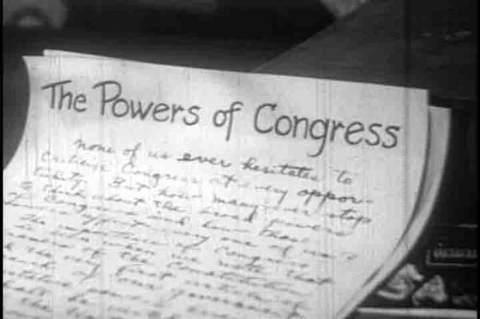
Powers Given to Congress
The Framers kept the goals of the Preamble in mind.
Powers are broad, but have limits.
5 Main Powers
Promoting the General Welfare
Providing for Defense
Establishing Justice
Unlisted Powers
Non-legislative Powers

Slide 13
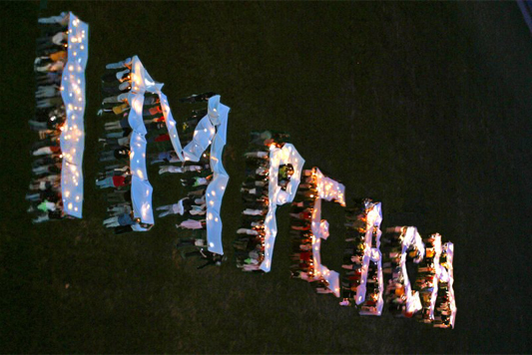
Powers
Promoting the General Welfare
  Regulating/limiting commerce
  Collect taxes and borrow money
  “Power of the purse” – final approval of government’s budget (plan for raising/spending $)
Providing for General Defense
  Establish and maintain an army and a navy.
  Sole power to declare war.
Establishing Justice
  Senate approves appointment of federal judges.
  House has power to impeach.
  Senate has power to try impeachments.
  Two presidents have been impeached but none have been convicted.

Slide 14
Powers
Unlisted Powers
  The elastic clause – Congress has power to make laws “necessary and proper” for carrying out listed powers.
Non-legislative Powers
  Powers that don’t deal directly with law-making.
  See chart on page 220 for a complete list.
  Impeach an official, confirm appointments, conduct investigations, etc.

Slide 15
Limits on the Powers of Congress
Limits: President’s veto, Supreme Court decisions and the Constitution.
If you were to be held in jail without a charge, a writ of habeas corpus would force the police to bring you to court to hear the charges.
Congress can’t pass bills of attainder.
  Convicts a person of a crime without a trial.

Slide 16
How Congress is Organized
Section Three

Slide 17
Congress Organizes!
Congress begins a new term every two years on odd years.
Two sessions: one per year
The House reorganizes every two years; however, the Senate never has to completely reorganize because only 1/3 of their seats are up every two years.

Slide 18
Leadership in Congress
House of Rep.
  Speaker of the House is presiding officer (Constitution).
  Floor leaders for the majority and minority party.
  Assistant floor leaders-whips
Senate
  Vice President of US is the presiding officer (can only vote in a tie) (Constitution).
  President pro tempore is next-presides when VP is absent (Constitution).
  Has floor leaders and whips too.

Slide 19
Leadership in the 112th Congress
The House of Representatives
The Senate
President/ VP
Joe Biden
President
Pro-Tempore
Daniel Inouye
Speaker
John Boehner
Majority Leader
Eric Cantor
Minority Leader
Mitch McConnell
Minority Leader
Nancy Pelosi
Majority Leader
Harry Reid
Majority Whip
Kevin McCarthy
Minority Whip
Steny Hoyer
Majority Whip
Dick Durbin
Minority Whip
John Kyl

Slide 20
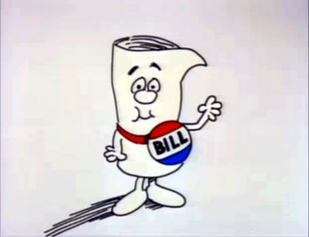
Committees
Constitution doesn’t tell Congress how to make laws.
They’ve developed procedures to consider bills.
They divide work of preparing bills among committees.
  Have leaders oversee committees.
Control the fate of bills.
More than 10,000 bills are introduced in one term of Congress!
  They need help!
  Hence….committees
  They are “experts”
Notes:
Have democratic and republican members
Chairperson is of the majority party

Slide 21
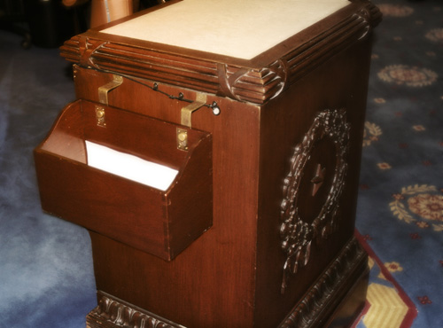
Introducing Bills
Only a member of Congress can introduce a bill.
They are placed in the hopper.
Marked based on where they were introduced: HR or S.
And then given a #.
Ex. S.1805

Slide 22

Standing Committees
16 permanent standing committees in the Senate.
20 permanent standing committees in the House.
Each standing committee deals with a specific area, like banking or education.
The committee decides whether to recommend that the House or Senate vote on the bill.
If the committee does not recommend it, it dies.

Slide 23
Select and Joint Committees
Select committees
  Formed to deal with a problem not covered in a standing committee.
Joint committees
  Made up of both members of the House of Representatives and Senate.
  Usually select committees, formed to conduct investigations.

Slide 24
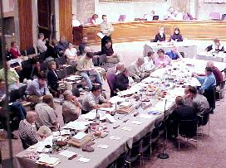
Conference Committees
If the two houses cannot agree on a bill, a conference committee is formed.
It is also a joint committee.
Tries to settle differences on a bill.

Slide 25
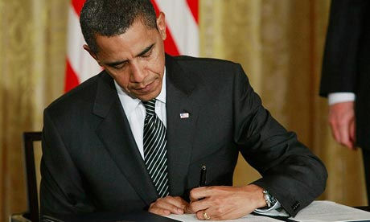
What about the President?
After a bill passes by a majority in both houses of Congress…it goes to the president.
He can sign it, veto it or pocket veto it.

Slide 26

President’s Role
Signature on a bill = becomes a law.
Veto (rejects) = sends back to Congress.
Congress can override with a 2/3rds vote.
Pocket veto = holding a bill for ten days, during which Congress ends its session.
  The bill will not become a law.
Why might the President choose to pocket veto a bill instead of just vetoing it?

Slide 27
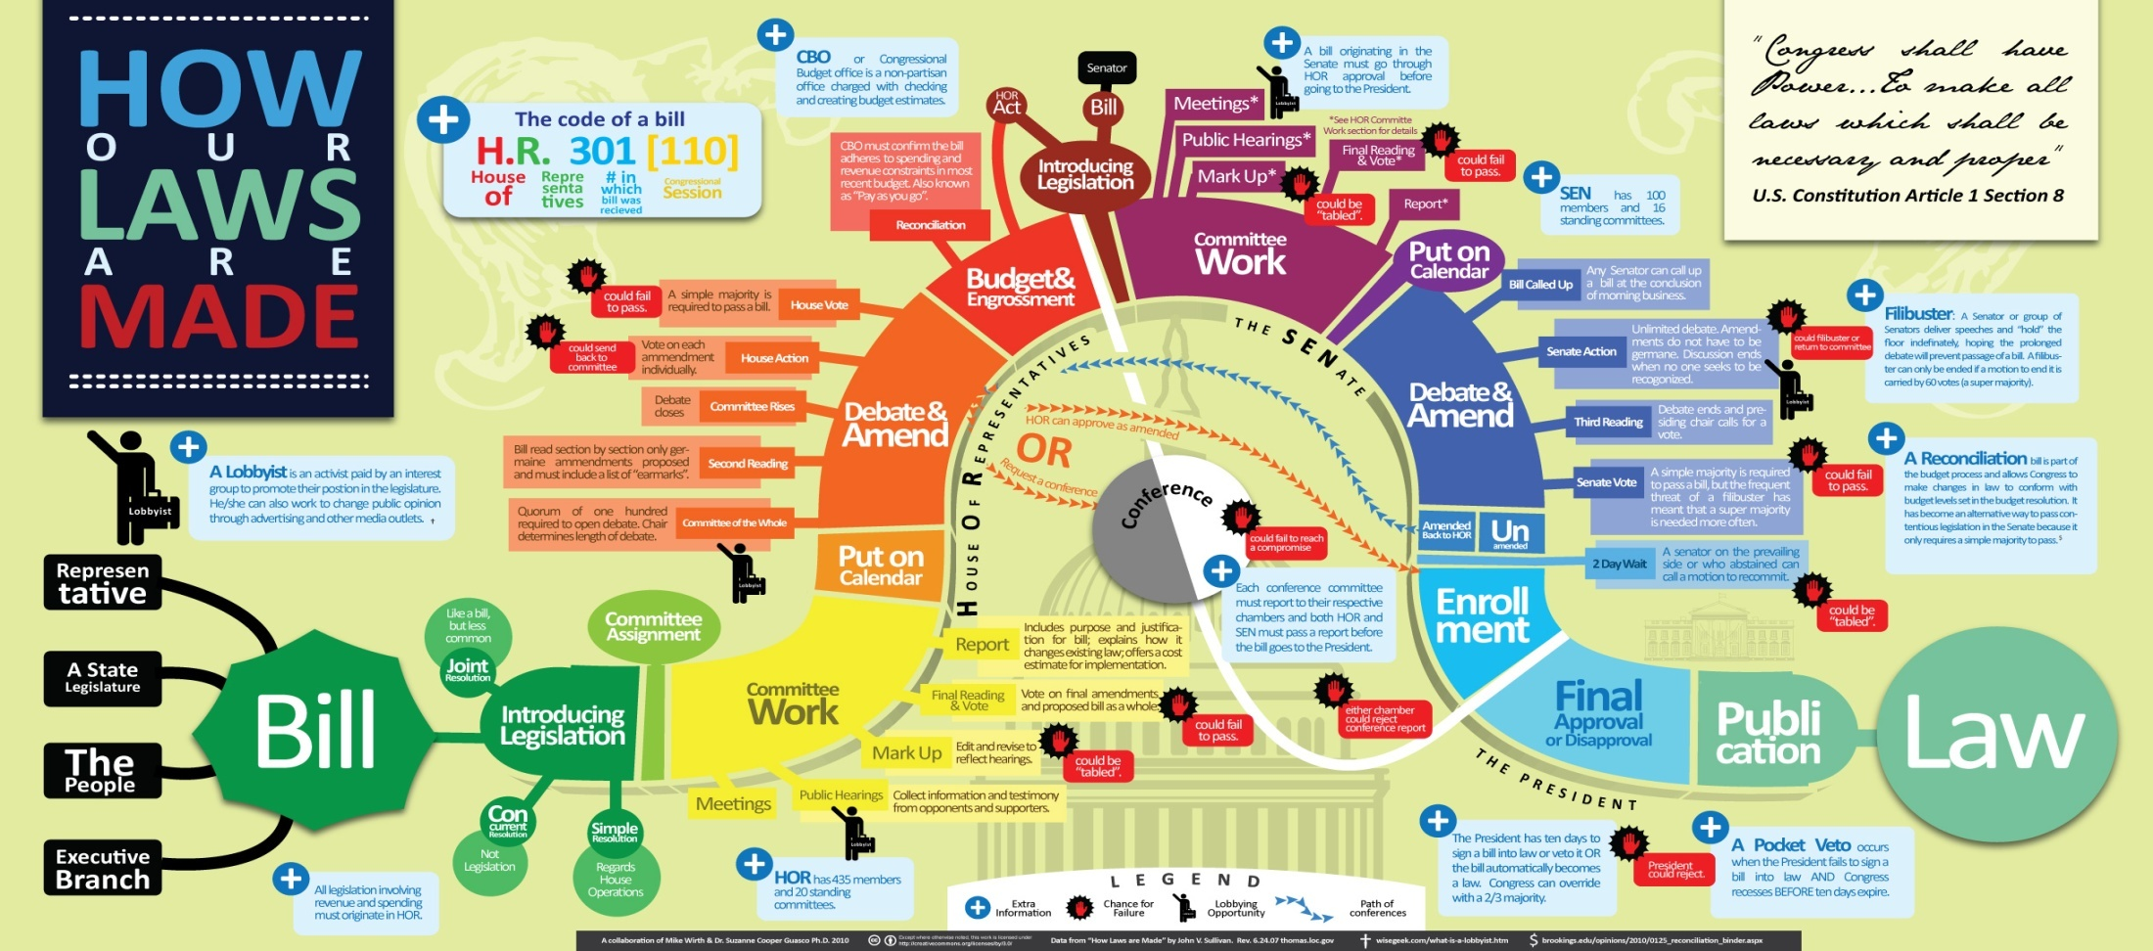
How a Bill Becomes a Law
See page 227.
Why do you think there are so many steps?
The Framers wanted bills studied with care.

Slide 28

Following a Bill in Congress
Chapter 8
Section 4

Slide 29
Stopping a Bill
If a committee recommends a bill be heard by the House or Senate it’s called reporting a bill.
The House has time limits on debates.
However, the Senate does not.
This can lead to a filibuster – the use of long speeches to prevent a vote on a bill.
If a party wants to block a bill from being passed, they will often start a filibuster.

Slide 30
Cloture
If a filibuster is started by one party, the other party will want to stop it.
The opposing party may call for cloture – agreement to end the debate on a bill.
Cloture requires 3/5ths vote.
If there are not enough votes, the filibuster can continue.
If the filibuster can’t be stopped, the Senate can’t vote on the bill.

Slide 31
Compromise Bills
If a bill doesn’t make it into a law, sometimes it just needs to be changed.
A compromise bill is what results from that change.
A compromise bill is often needed to get a majority vote or the President’s signature.

