Slide 1
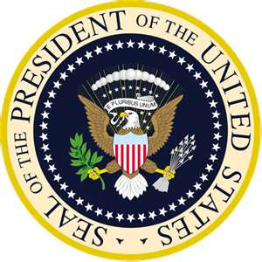
CH 9 The Executive Branch

Slide 2
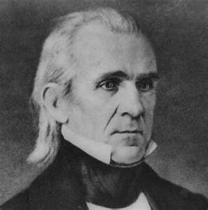
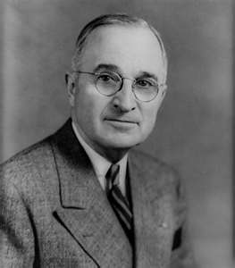
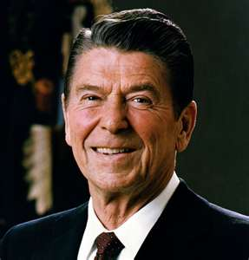
Presidential Quotes
Though I occupy a very high position, I am the hardest working man in the country. James K. Polk (1845-1849)
Being a President is like riding a tiger. A man has to keep on riding or be swallowed. Harry S. Truman (1945-1953)
You don't become President of the United States. You are given temporary custody of an institution called the Presidency, which belongs to our people. Ronald Reagan (1981-1988)

Slide 3
Creating the Office of President
The framers of the Constitution did not want a leader with unlimited powers. The memory of British tyranny was fresh in their minds.
To calm the public’s fears, they gave very few specific powers. They also included ways to prevent abuse of power.

Slide 4
Presidential Specifics
Term of Office The President is elected to a term of four years. They can be reelected for a second term. No President may hold the office for more than two terms.
Qualifications & Salary Must be 35 years old. A natural-born citizen of the US. Must have lived in the US for at least 14 years.
Limited Power The founders established Checks & Balances amongst the three branches of government. President cannot make laws but can only enforce those made by Congress.

Slide 5
Leader With Many Roles
The framers did not describe exactly how the President should fulfill the duties of the new office. The nations first Presidents helped define the many roles that future Presidents would follow.
Chief Executive
The President serves as chief executive, or head of the executive branch. The Constitution states the President must “take care that the laws be faithfully executed” This means they must be carried out.
The President can give executive orders, which are rules and regulations that government must follow.
The President appoints about 4,000 executive branch officials. A check on that power, is that Congress must confirm or approve many top appointments.

Slide 6
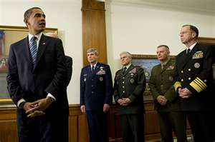
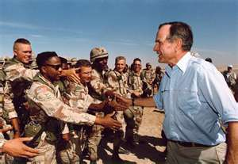
Roles – Commander in Chief
The Constitution states that “The President shall be commander in chief of the army and navy of the United states.”
The President is surrounded by military leaders who run day to day operations. The President may send troops abroad to protect American interests even if Congress has not declared war. A restriction on this power is the War Powers Resolution, which was passed after the Vietnam War. It states that troops may not remain more than 60 days without the approval of Congress.

Slide 7
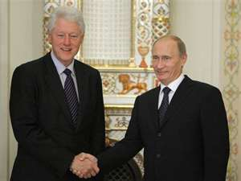
Roles – Chief Diplomat
The President is the most important representative of the US in relations with other nations. The President leads in making foreign policy, which is our set of plans guiding our nation’s relationships with other countries.
The President may make treaties, or formal agreements with other countries, but the Senate may reject any treaty.
The President also appoints ambassadors, which are official representatives to foreign governments. Once again, the Senate must approve the appointments.
The President can make Executive Agreements with other countries that do not require Senate approval. They may set goals between nations or promise to give aid.

Slide 8
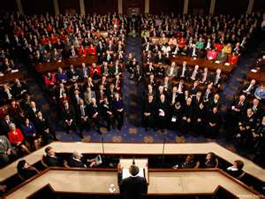
Roles – Legislative Leader
Congress makes our nation’s laws, but the President has significant power to influence potential laws and how they will be enforced.
The Constitution states the President may recommend to Congress “such measures as he shall judge necessary and expedient.” This means Congress should consider the President’s ideas and not act alone.
Each year, the President gives the State of the Union Address to both houses of Congress. It allows him the opportunity to set forth America’s foreign policy. The President also targets problems within the US and gives ideas for solving them. This is referred to as domestic policy.

Slide 9
Roles – Legislative Leader Cont
The President may persuade Congress to make foreign or domestic policy into laws by meeting with the members. He can also give speeches to interest groups and the public to gain support for the bills.
The President has a very powerful tool that can influence Congress to present bills more to the President’s liking. A President may veto bills passed by Congress that he deems not in the best interest of the country. Congress has only overridden 4 percent of the 2,500 vetoes in the nations history.
The President also prepares and presents a budget to Congress. This details how to pay for the President’s proposed programs.
The President can also call a special session of Congress if they are not meeting. This is done if a national emergency or disaster occurs.

Slide 10
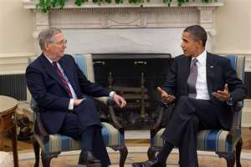
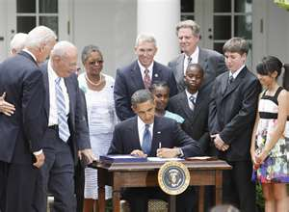
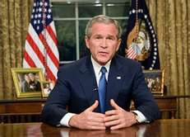
Roles – Legislative Leader Cont

Slide 11
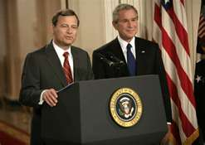
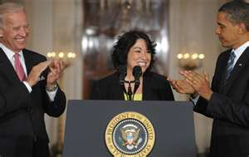
Role – Judicial Powers
As part of the system of checks and balances, the President chooses Supreme Court justices and other federal judges. The Senate, must confirm these appointments.
The President my limit the power of the Judicial Branch by issuing a commutation on a sentence. This reduces the punishment of an individual convicted of a crime. They may also issue a pardon which releases an accused from punishment.

Slide 12
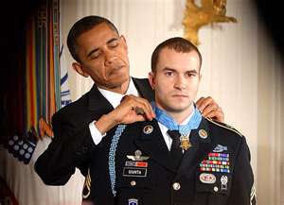
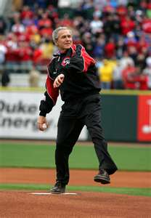
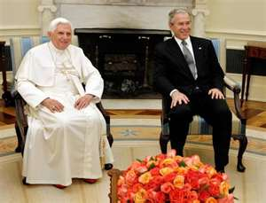
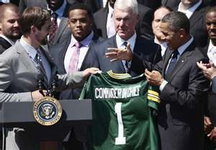
Roles Created by Tradition
Over time, the President has taken on two unofficial roles: Party Leader & Chief of State
The President, either Democrat or Republican, is considered to be the party leader. They use their power and prestige to support party goals or candidates. The President will give speeches and attend fundraisers to help support members of his party who are running for office.
As Chief of State the President is expected to speak for all Americans. He will award medals to citizens and greet visiting leaders.

Slide 13
Section Two
The Organization of the Executive Branch

Slide 14
As our nation has grown, the President’s duties have grown, too. To fulfill their many duties, Presidents have needed more and more help. Today it is the largest branch of government today.
As it has grown, the executive branch has become a huge bureaucracy.
To help direct the bureaucracy, the President appoints an administration, who helps the administration in three main parts of the executive branch:
Executive Office of the President
Executive Departments
Independent Agencies

Slide 15
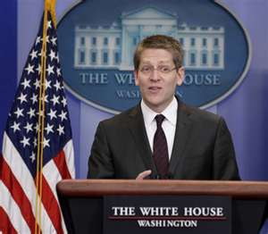
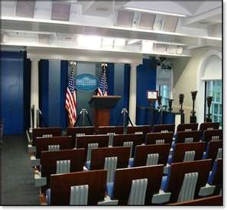
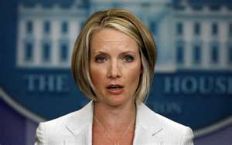
The Executive Office of the President
The main job of the Executive Office is not to carry out laws directly, but to advise the President on important matters.
The White House Staff includes the President’s most trusted advisers and assistants. They give the President advice and information on national security, economy, and other matters.
The staff includes a Chief of Staff, key advisers, press secretaries, legal experts, speechwriters, and researchers. All members of the staff are appointed or hired by the President, without the need of Senate approval.

Slide 16
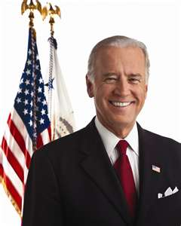
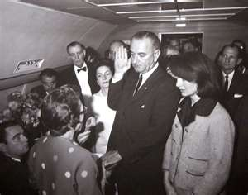
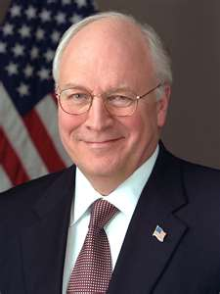
Executive Office – Vice President
The Constitution gives the Vice President no duties other than presiding over the Senate. The President decides what the VP’s will do.
Some may ask the VP to play an active role. It might include heading special commissions, visiting foreign countries, and working with Congress. Historically, the VP has been almost invisible. Because of this, some leaders have refused to run for VP.
If the President dies, though, the VP may become President. This has occurred eight times in our nation’s history. The VP may also be asked to serve as “acting President” if the President falls seriously ill.

Slide 17
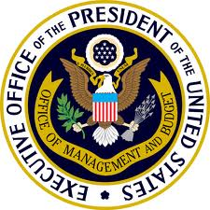
Special Advisory Groups
Two very important groups that help the President make decisions on domestic foreign policy.
Office of Management and Budget (OMB) decides how much the Presidents policy goals will cost. They also prepare the budget that is sent to Congress.
The National Security Council helps the President create foreign policy. They include top military officials and advisers from other government agencies.

Slide 18
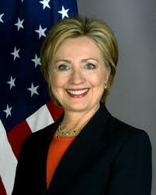
Executive Departments
Today, the executive departments are made up of 15 organizations and form the largest part of the executive branch.
The Department of State handles relations with foreign countries. The Department of Defense helps the President by running the armed forces.
The newest executive department is Homeland Security which was created by President George W. Bush in response to the terrorist attacks of September 11, 2001.
The President appoints the head of each executive department. As a check on presidential power, the Senate must approve each appointment. The department heads are referred to as Secretary, the head of the Department of Justice is referred to as Attorney General.

Slide 19
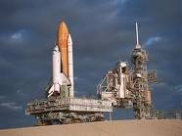
Independent Agencies
Executive Agencies are under direct control of the President. The more important agencies include the National Aeronautics and space Administration (NASA) & the Environmental Protection Agency (EPA).
Regulatory Commissions makes and carries out rules for a certain business or economic activity. They are meant to be independent from political influence.
The Federal Communications Commission (FCC) makes rules for radio and TV stations. The Consumer Product Safety Commission (CPSC) sets safety standards for household products

Slide 20
Section Three
Presidents and Power

Slide 21
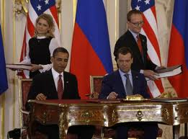
Freedom to Take Action
The President has does not have to seek permission to talk with representatives of other countries.
The President’s talks can result in executive agreements, agreements with other countries, which do not need Senate approval.
Other talks can lead to treaties, formal agreements between nations. These do require Senate approval.
A protection for the President’s independence is executive privilege. This is the right to keep some information secret from Congress and the courts. This is used if the nation’s safety depends on keeping certain information secret.

Slide 22
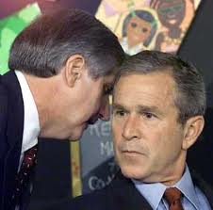
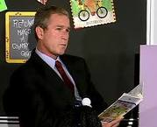
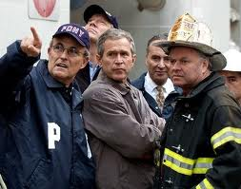
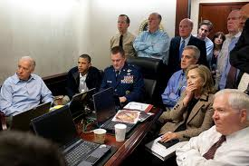
Seeking a Balance
The President can act independently of Congress in certain situations. This is so the President can act quickly when necessary, such as a national crisis.

Slide 23
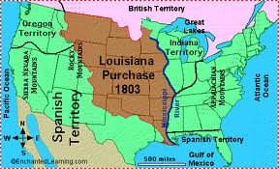
Presidential Power – Jefferson & the Louisiana Purchase
In 1803 French ruler Napoleon offered to sell the Louisiana Territory to the US for 15 million. The purchase would double the size of the US.
The Constitution did not say that the President or Congress could buy territory. A Constitutional amendment would take too long, and Napoleon wanted to sell quick.
Jefferson used the President’s ability to make treaties and accepted the French offer. The Senate ratified the treaty and paid for the territory.

Slide 24
Presidential Power – Truman and the Steel Mills
In 1952, during the Korean War, President Truman was faced with a dilemma. The steelworkers were on the verge of going on strike which could hinder the war effort.
President Truman gave an executive order placing the Secretary of Commerce in control of the steel mills. The owners of the steel companies disagreed and sued the Federal government.
The Supreme Court ruled that the President had no right to seize private property even in a national emergency.

Slide 25
Presidential Power – Nixon and Watergate
In 1972, members of the Nixon administration, permitted the break-in of the Watergate office building in Washington D.C. The purpose of the break-in was to help get Nixon reelected by discovering the Democrat’s campaign plans.
The burglars were caught in the act and it was discovered that members of the White House staff helped plan the burglary and later cover it up.
A Senate and House committee investigated the President and found that he had secretly taped conversations. They asked to examine the tapes, but Nixon refused claiming executive privilege. In 1974, the Supreme Court ordered Nixon to turn over the tapes, stating executive privilege was not unlimited power.
Nixon resigned the Presidency before the House could vote to impeach.

